Slide 1


PHARMA CURE
Pharma Cure
Demo

Slide 2


Agenda
About the Company | 3
Supply Chain Management Team | 4
Problem statement & Business Requirements | 5-9
Inventory Module Setup | 10-14
Inventory management | 15-32
Procurement to pay cycle | 33-57

Slide 3



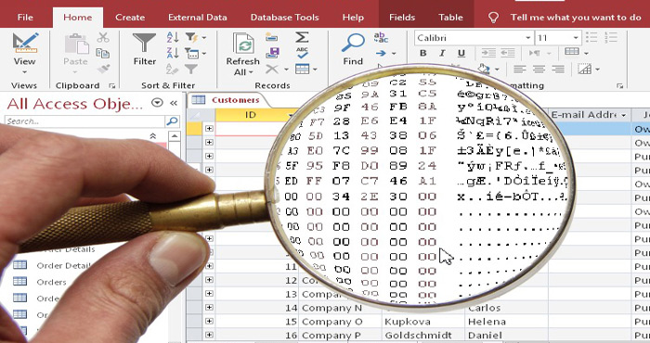
Introduction
We are a dynamic group of freelancers known as SmartOra Solutions. Our team specializes in Oracle Supply Chain Management (SCM) solutions, and we are excited to present our latest demo project on a popular freelancing platform. This project focuses on the Oracle Supply Chain Procurement Module, designed to address the challenges faced by companies still relying on paper-based processes

Slide 4
Aml Saleh
Oracle SCM Consultant
Asmaa Elmahdy
Oracle SCM Consultant
SmartOra Solutions SCM Team
Eman Saleh
Oracle SCM Consultant
Mary Gamal
Oracle SCM Consultant
Nehal Omran
Oracle SCM Consultant
Reda Abdelhakim
Oracle SCM Consultant
Youssef Iskanderous
Oracle SCM Consultant

Slide 5
Problem Statement
Many companies continue to use outdated, paper-based methods for their procurement processes.
This approach is not only time-consuming but also prone to errors, inefficiencies, and lack of real-time visibility.
These issues can lead to delays, increased costs, and difficulties in managing supply chain operations effectively.
Problem Statement

Slide 6
Our demo project showcases how the Oracle Supply Chain Procurement Module can revolutionize procurement processes. By digitizing and automating procurement activities, our solution offers:
Enhanced Efficiency: Streamlined workflows reduce processing time and minimize errors.
Real-Time Visibility: Access to up-to-date information enables better decision-making and improved supply chain management.
Cost Savings: Reduced paperwork and manual tasks lead to significant cost reductions.
Improved Compliance: Automated processes ensure adherence to procurement policies and regulations.
.
Our Solution

Slide 7
Problem Statement
We believe our innovative solution will help companies transition from paper-based systems to a more efficient, digital procurement process, ultimately enhancing their overall supply chain performance..
Transforming Procurement:
From Paper
To
Digital Excellence

Slide 8
Background
Pharma Cure is a pharmaceutical distributor in Egypt. The company procures medicines from local pharmaceutical manufacturers and distributes them to pharmacies and government entities.
As an Oracle SCM Consultant, our role is to implement the Oracle Procurement Module ( Purchase to pay cycle )for the company while ensuring seamless Inventory Management for different dosage forms.

Slide 9

Business Requirements
Establish Inventory Organizations for different dosage forms. Implement multi-location inventory management. Configure currency, accounting, warehouse structures, Implement procurement module and purchase to pay cycle

Slide 10

Inventory Module
Setup

Slide 11
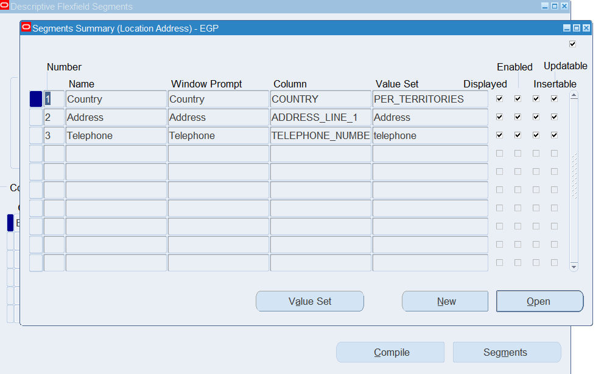
Define Address Style

Slide 12
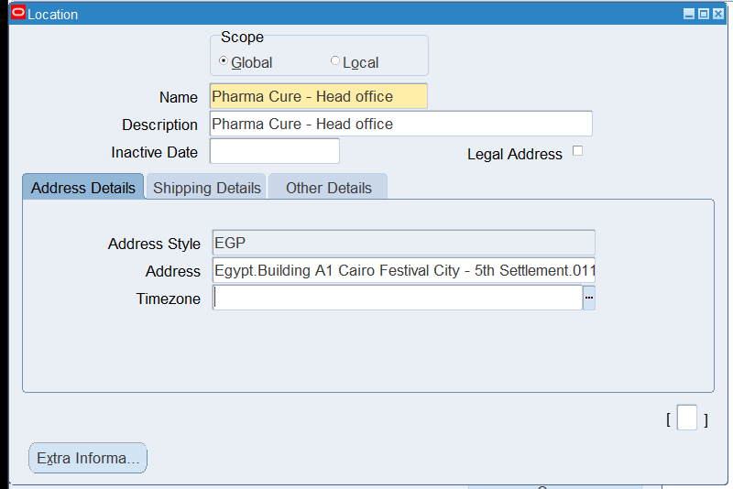
Define Locations
Notes:
Navigate to HRMS > Locations Create Warehouse Locations

Slide 13
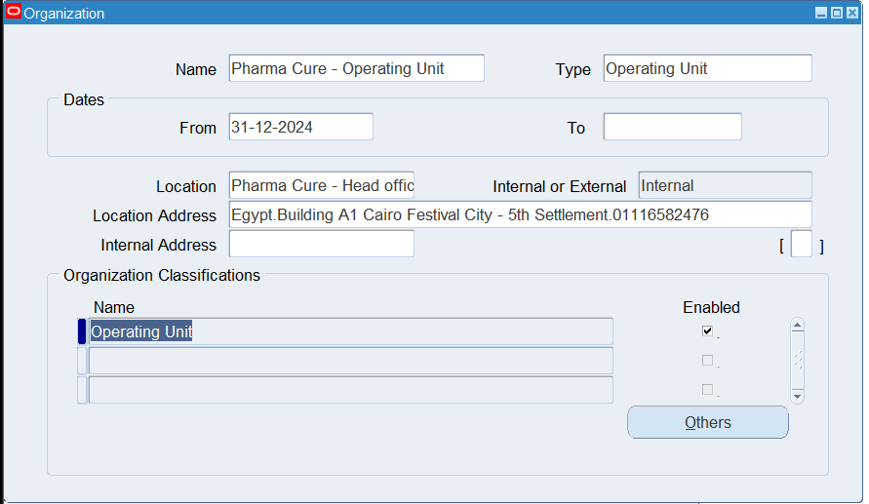
Create Operating Unit
Notes:
Navigate to System Administrator > Define Operating Units Enter Operating Unit Name (e.g., Pharma Cure OU) Link it to the Legal Entity and Assign the necessary MO: Security Profiles

Slide 14
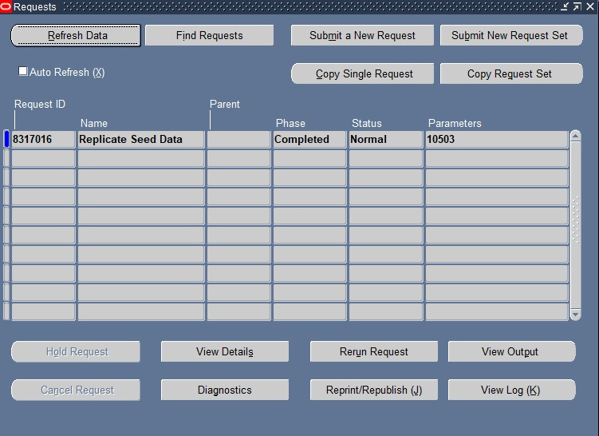
Create Operating Unit
Notes:
Navigate to System Administrator > Define Operating Units Enter Operating Unit Name (e.g., Pharma Cure OU) Link it to the Legal Entity and Assign the necessary MO: Security Profiles

Slide 15
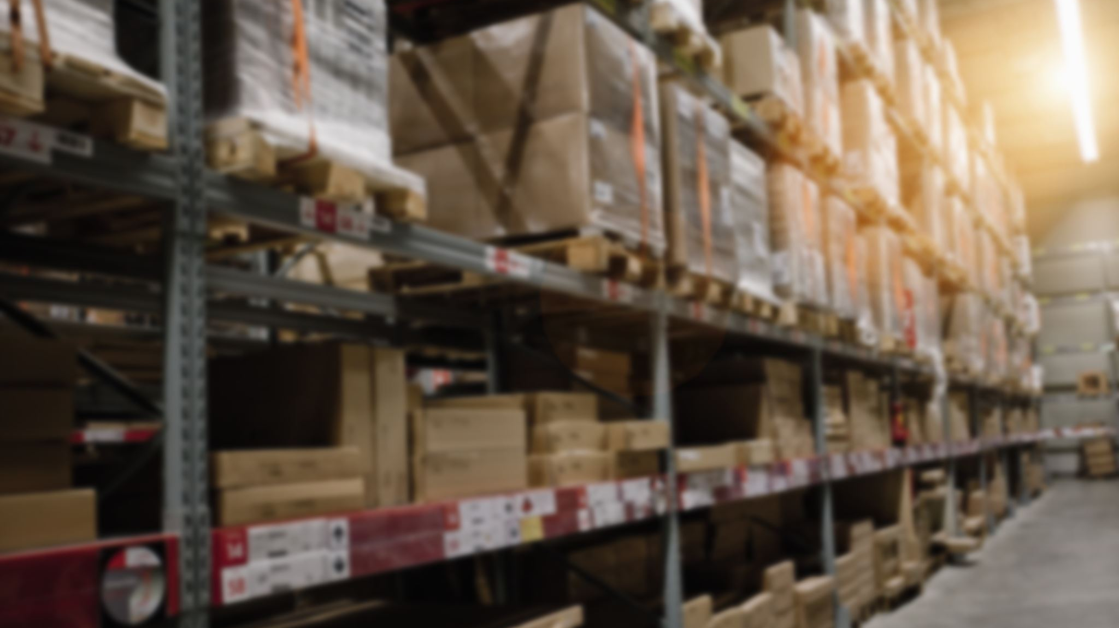
Inventory Management

Slide 16
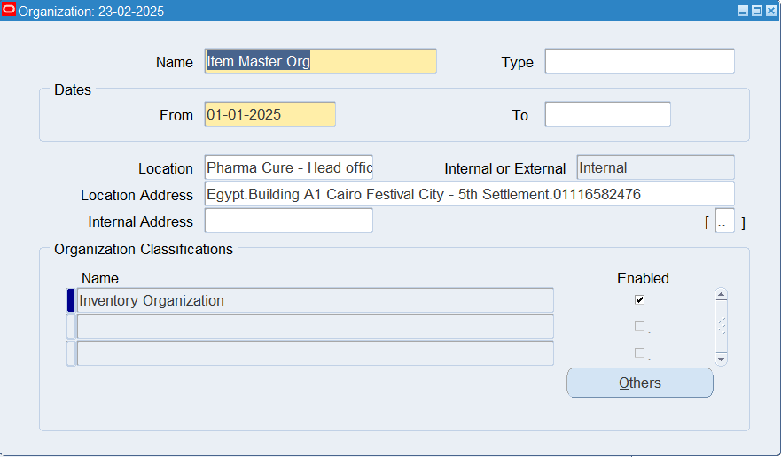
Inventory Organization Setup –Item Master Organization
Notes:
Create Inventory Organizations Defined Master Inventory Org Created Solid & Liquid Dosage Warehouses

Slide 17
Inventory Organization Setup
Notes:
Create Inventory Organizations Defined Master Inventory Org Created Solid & Liquid Dosage Warehouses

Slide 18
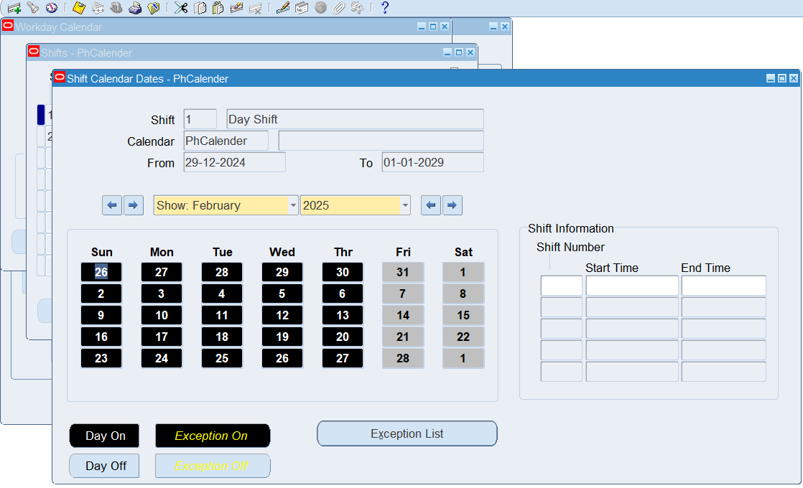
Configure Organization Parameters Assigned Calendar

Slide 19
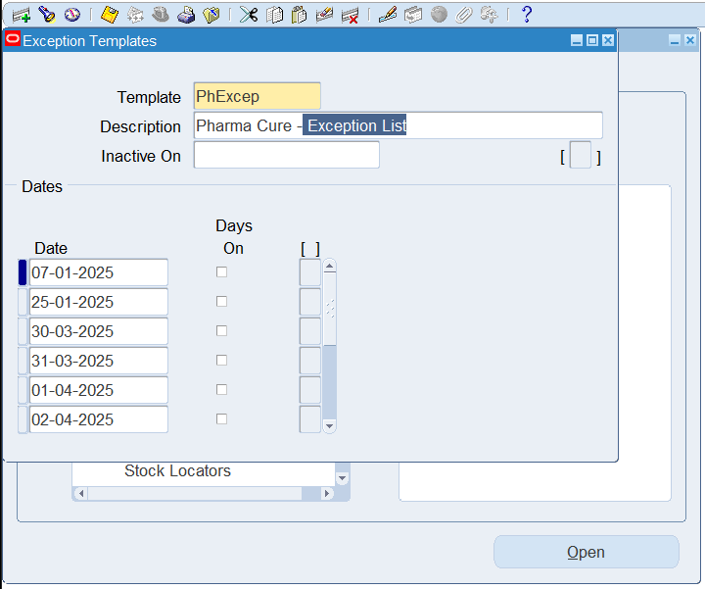
Configure Organization Parameters Assigned Calendar

Slide 20
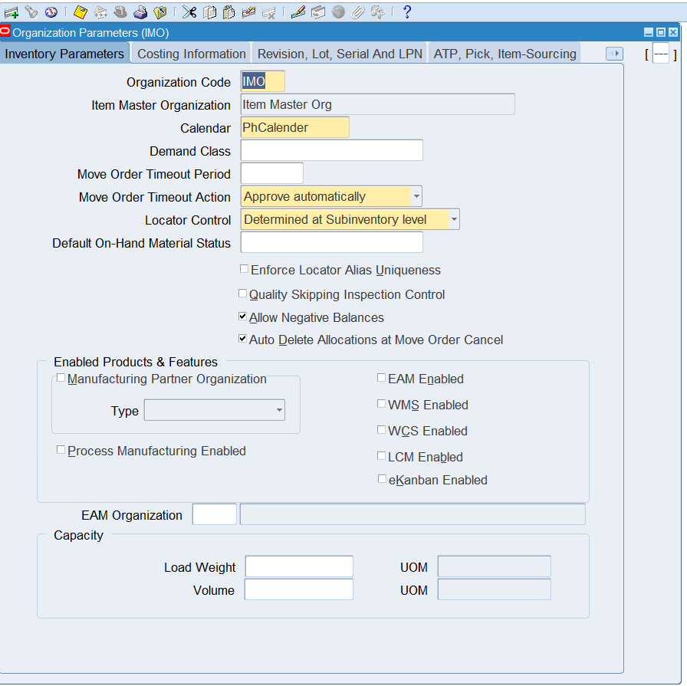
Configure Organization Parameters Assigned Calendar

Slide 21
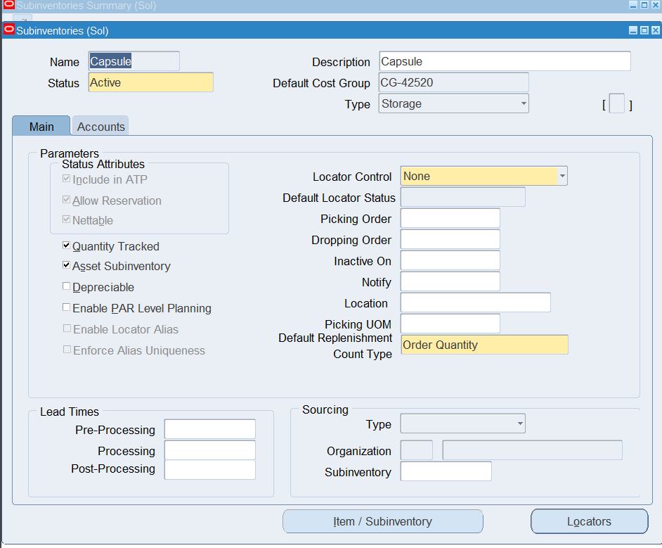
Create Sub inventories Solid Dosage: Capsules & Tablets Liquid Dosage: Syrups & Suspensions

Slide 22
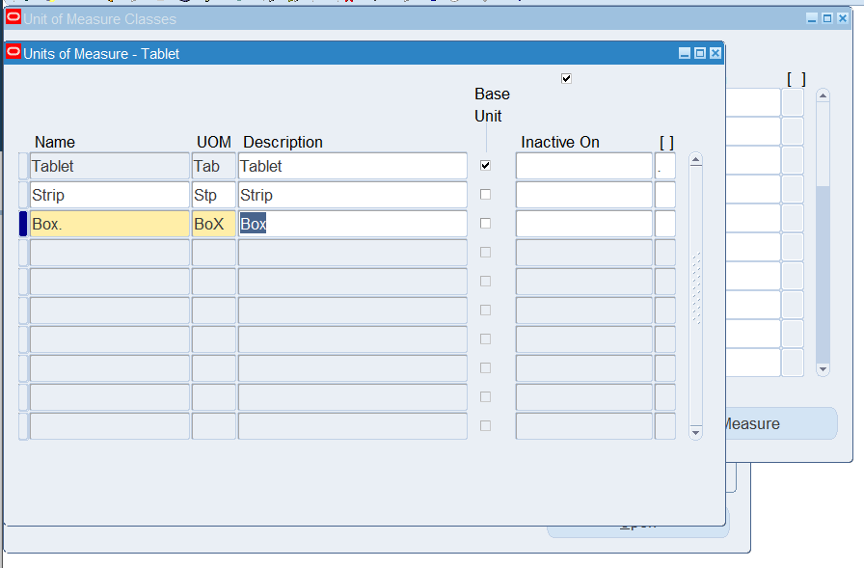
Unit of Measure (UOM) Setup for Inventory Items
Notes:
Setup > Units of Measure Created and assigned UOM Classes for pharmaceutical items Defined relevant Primary UOMs (e.g., Box, Bottle, Strip, Tablet, etc.)

Slide 23
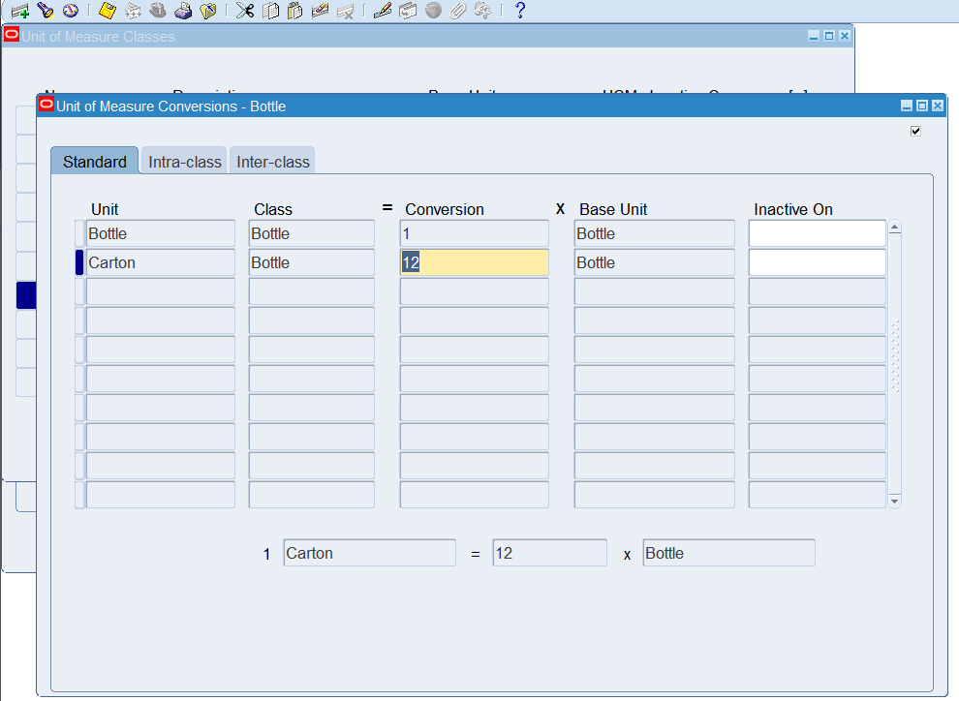
Unit of Measure (UOM) Setup for Inventory Items
Notes:
Navigated to Inventory > Setup > Units of Measure Created and assigned UOM Classes for pharmaceutical items Defined relevant Primary UOMs (e.g., Box, Bottle, Strip, Tablet, etc.)

Slide 24
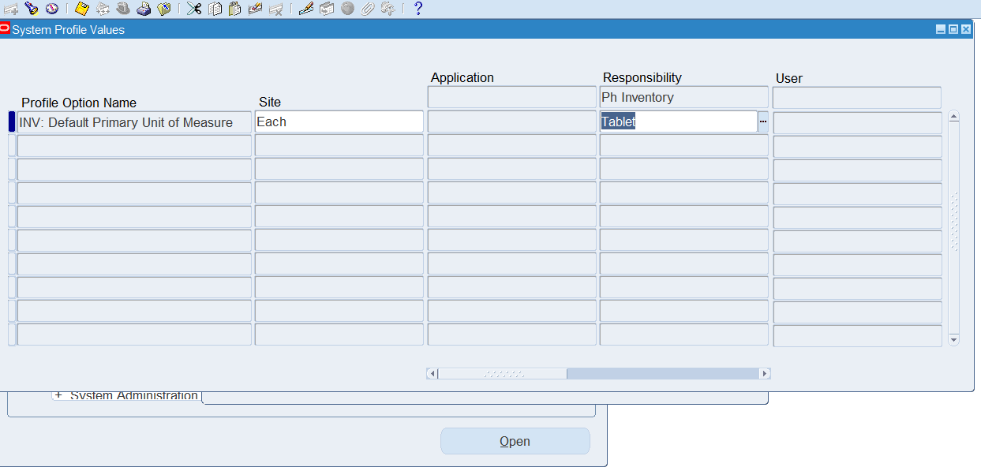
Primary Unit of Measure

Slide 25
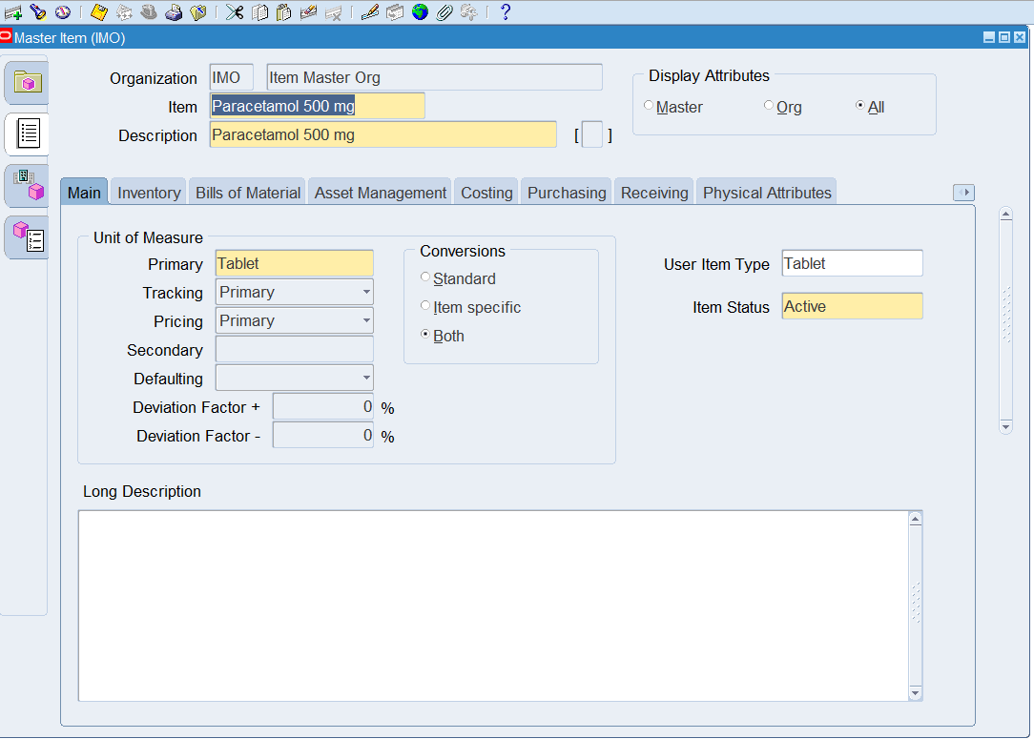
Item Creation & Assignment
Notes:
Define Items in Master Item Org Created 8 Inventory Items :1.Tabs>Paracetamol

Slide 26
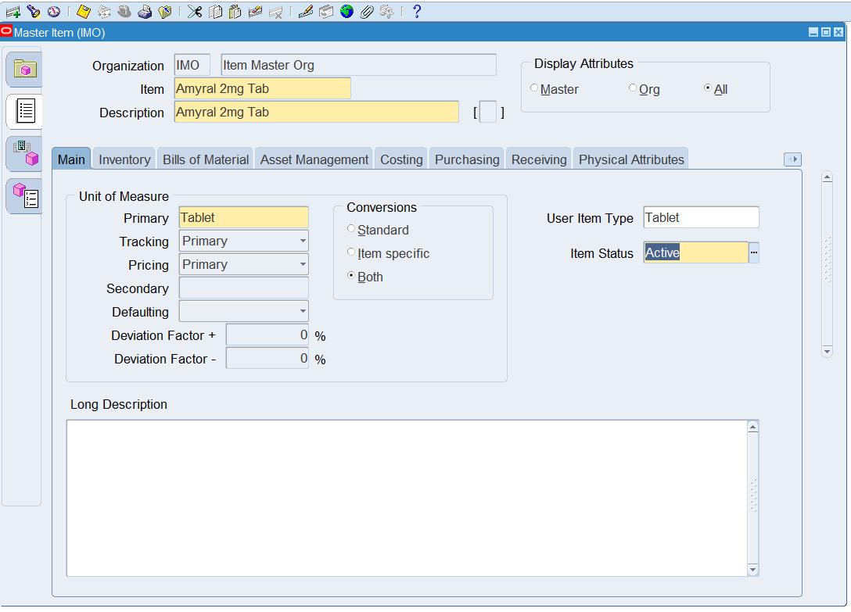
Item Creation & Assignment
Notes:
Define Items in Master Item Org Created 8 Inventory Items :1.Tabs>Amyral

Slide 27
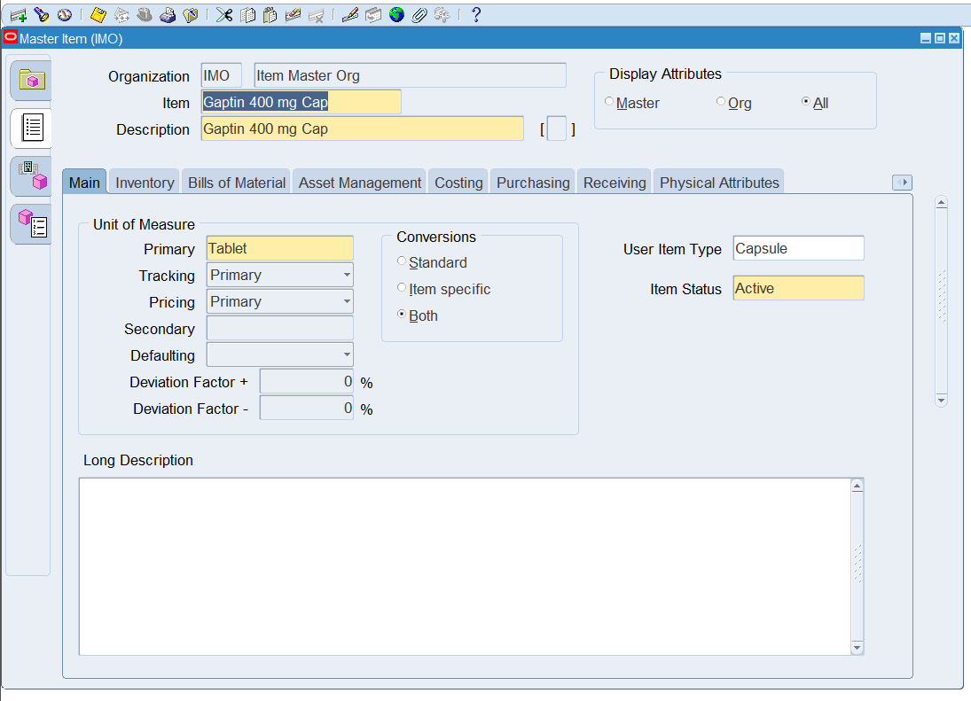
Item Creation & Assignment
Notes:
Define Items in Master Item Org Created 8 Inventory Items :2.Caps>Gaptin

Slide 28
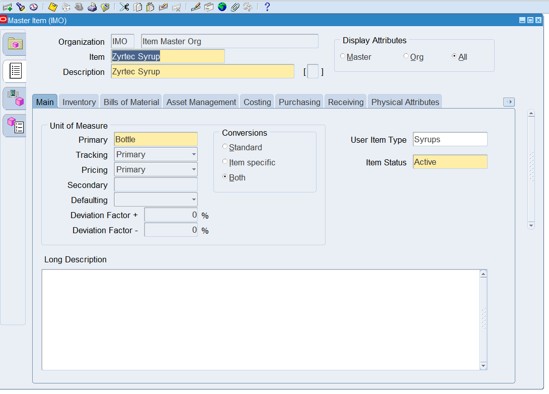
Item Creation & Assignment
Notes:
Define Items in Master Item Org Created 8 Inventory Items :2.Syrup>Zyrtec

Slide 29

Item Creation & Assignment
Notes:
Define Items in Master Item Org Created 8 Inventory Items :2.Susp>E-Mox

Slide 30



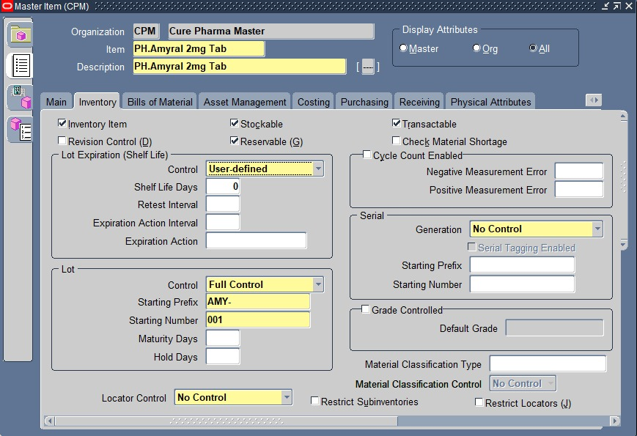

Slide 31
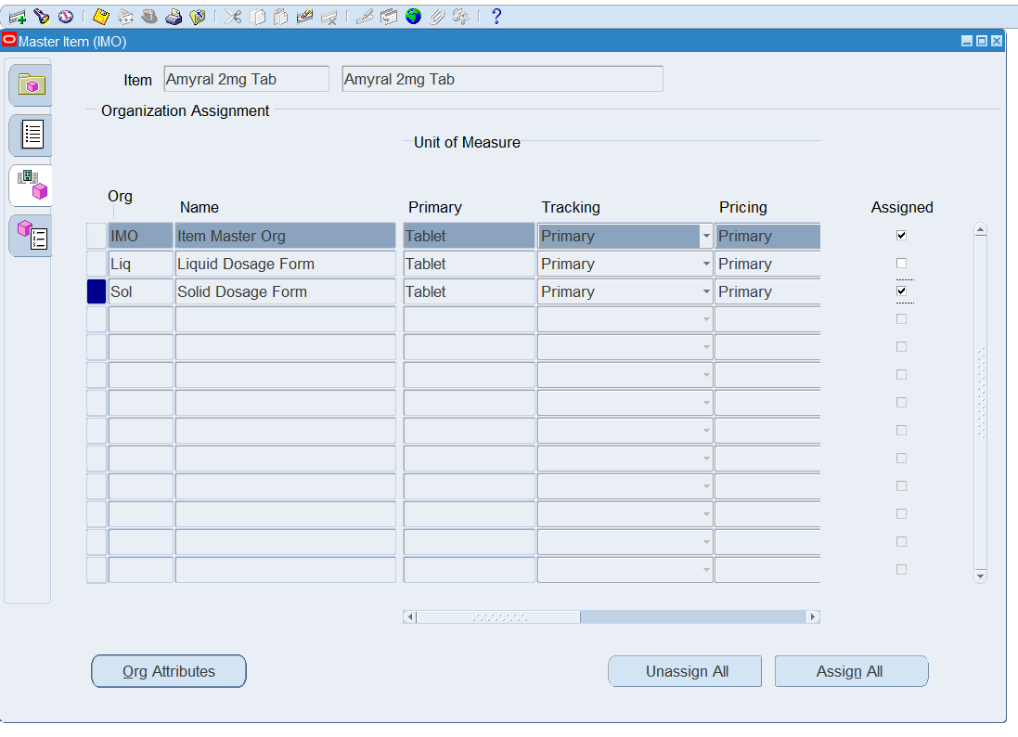
Assigned items of Master Item to Inventory Organizations

Slide 32
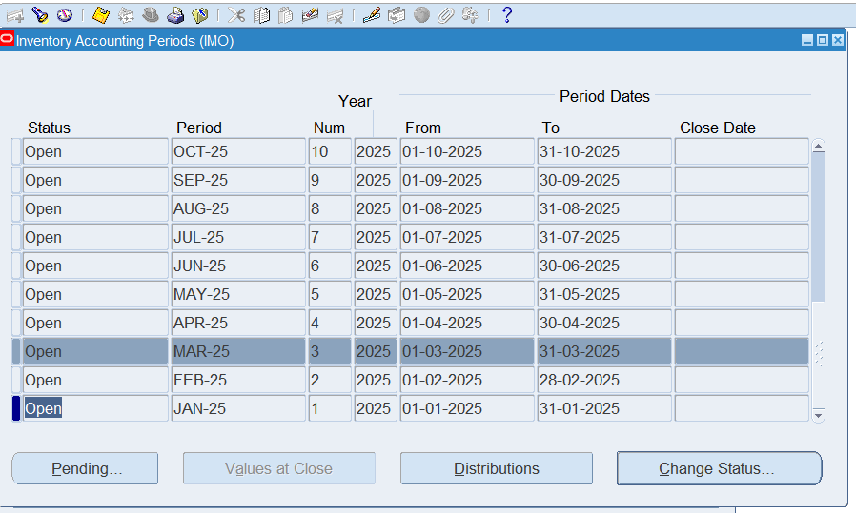
Open Accounting Periods

Slide 33

This Photo by Unknown Author is licensed under CC BY-SA

Slide 34
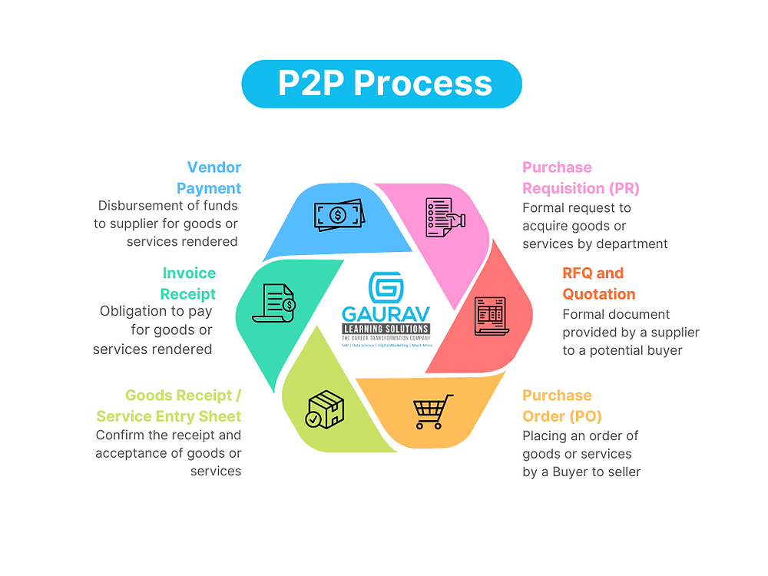

Procurement
to Pay
cycle

Slide 35
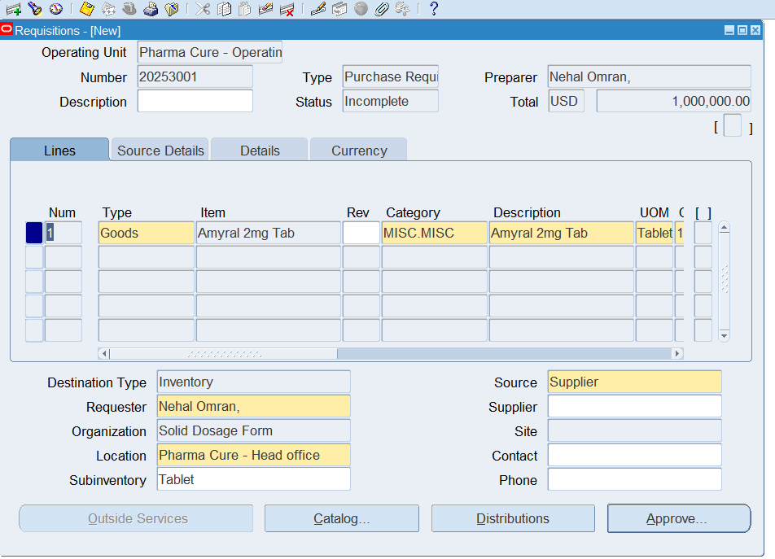
Create PR

Slide 36
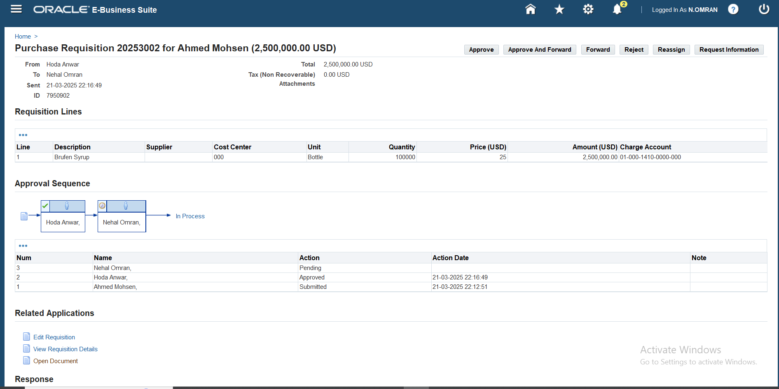
Approval Path

Slide 37
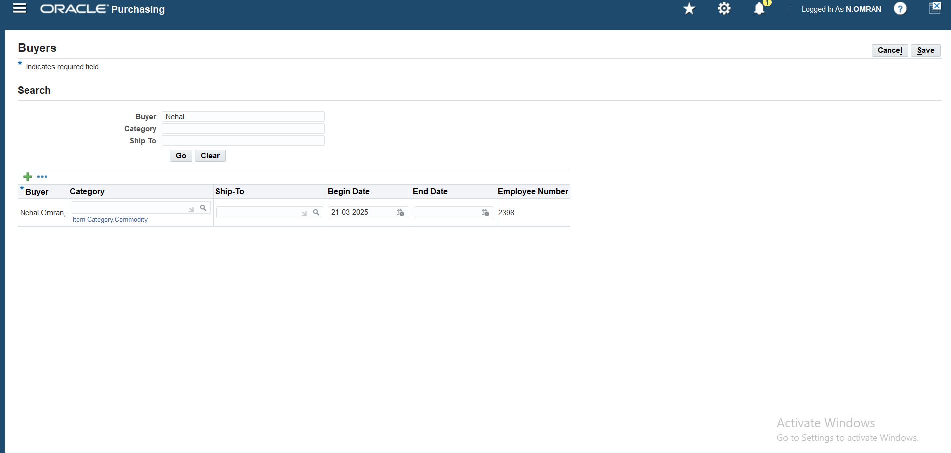
Define Buyer

Slide 38
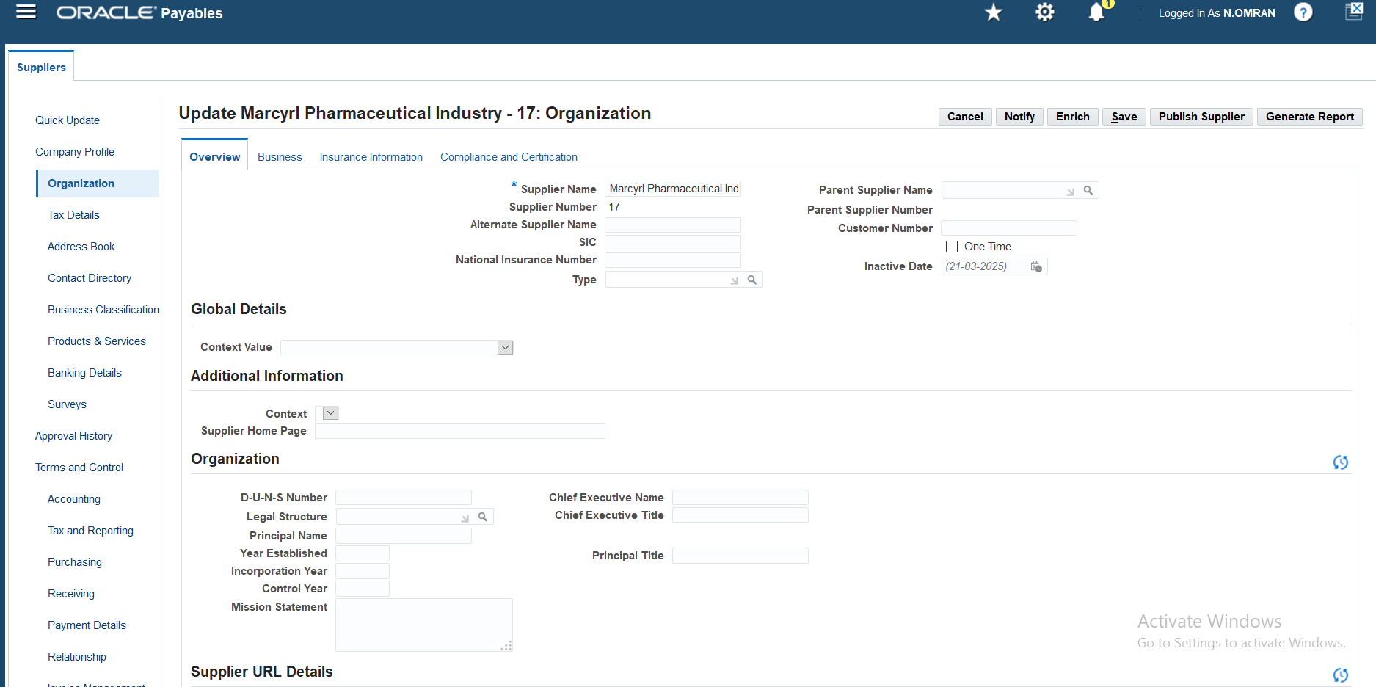
Create Supplier

Slide 39
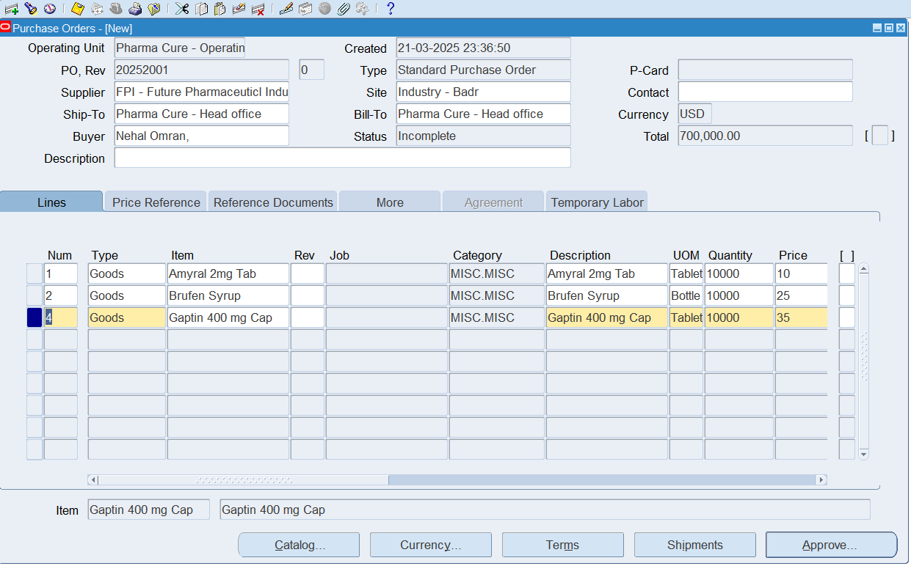
Create PO

Slide 40
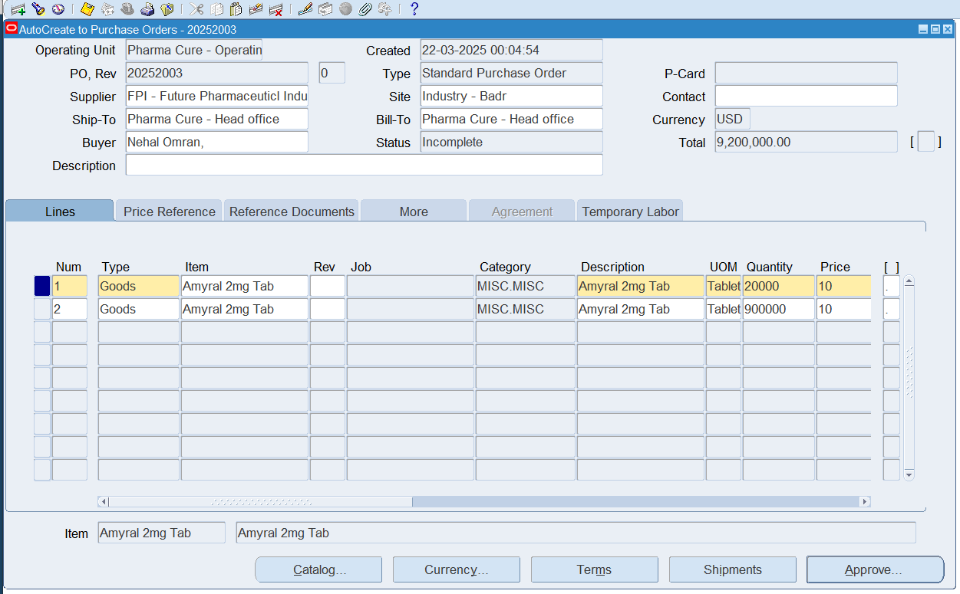
Auto Create to Purchase Order

Slide 41

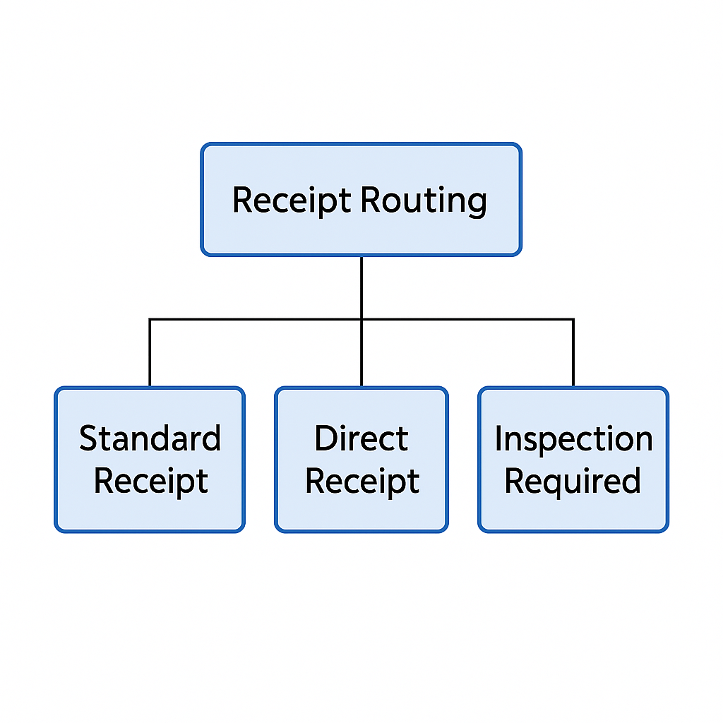

Slide 42
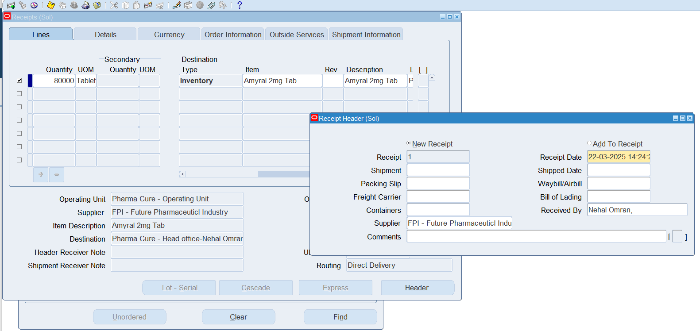
Direct Receipt

Slide 43
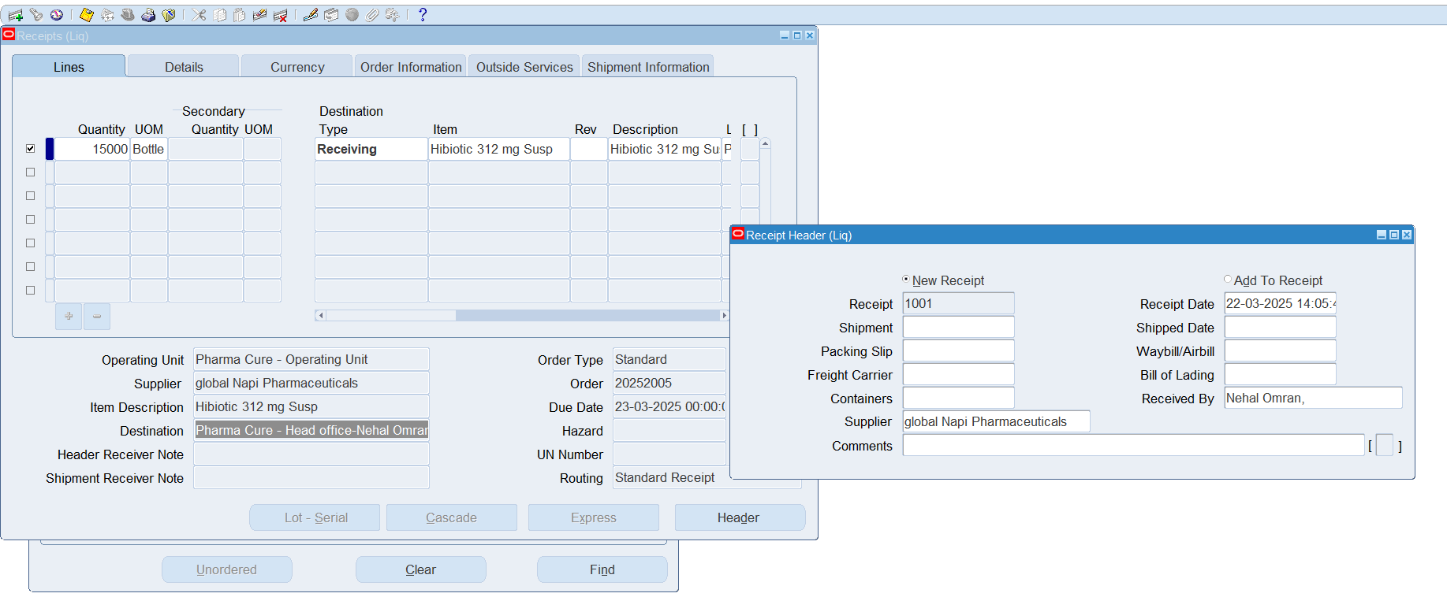
Standard Receipt

Slide 44
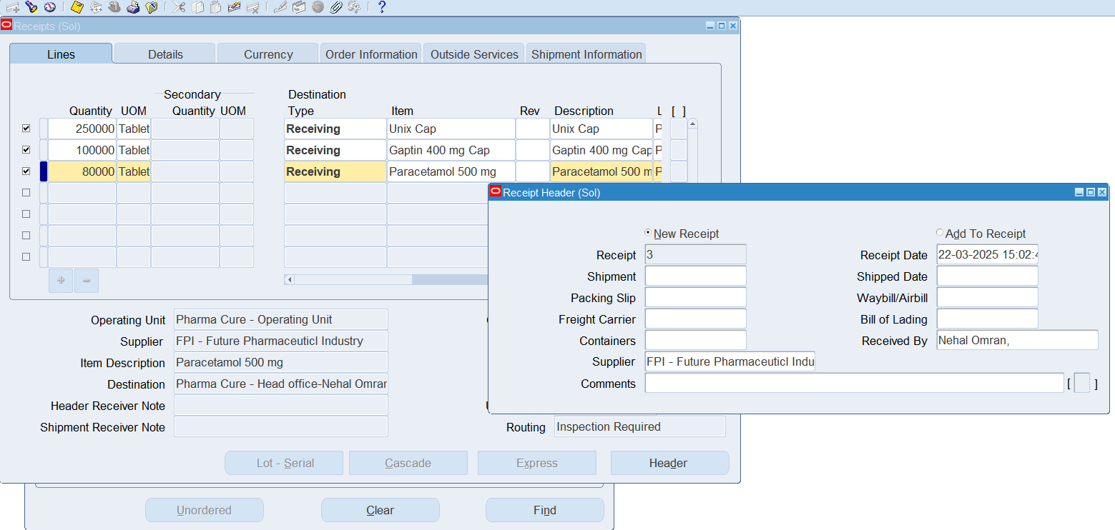
Inspection Required

Slide 45
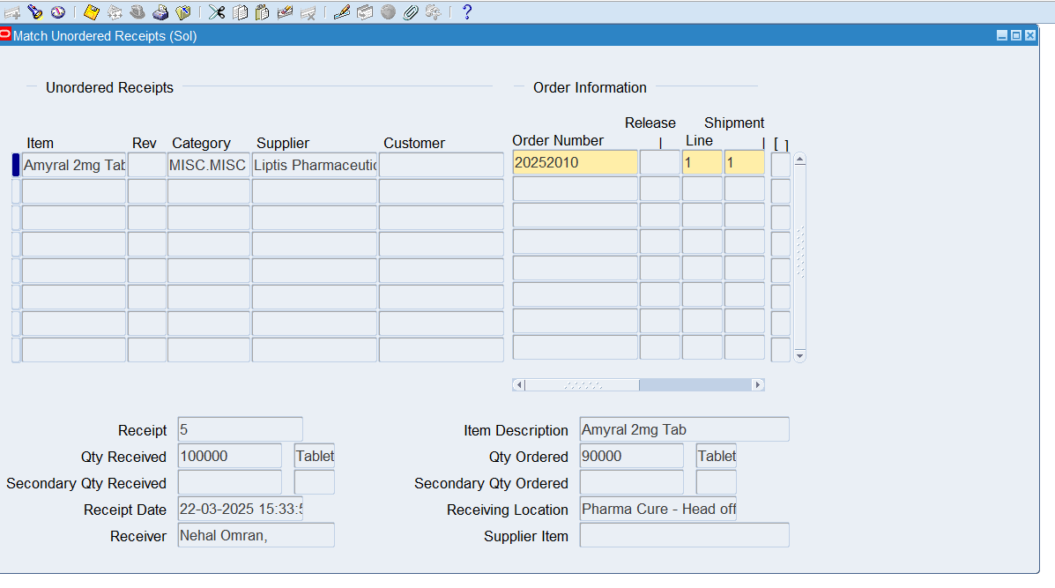
Unordered Receipt

Slide 46

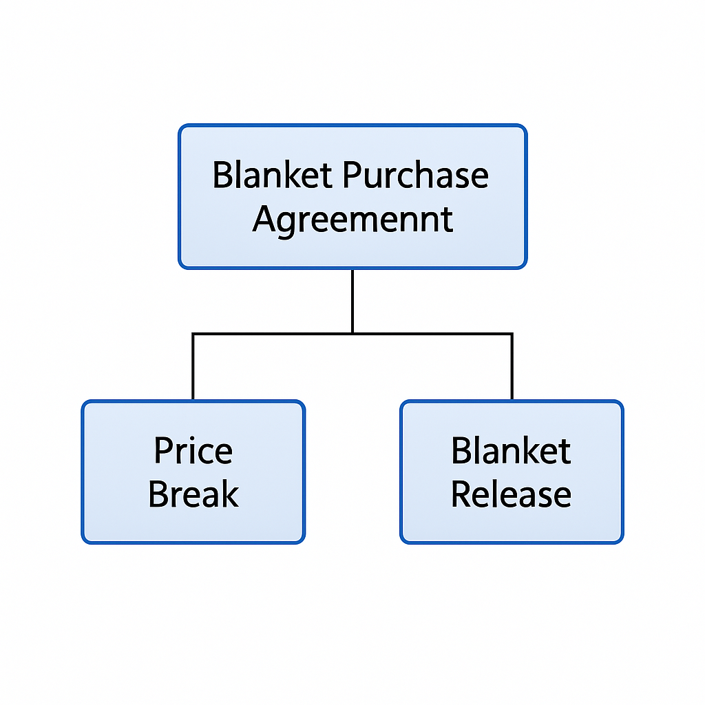

Slide 47
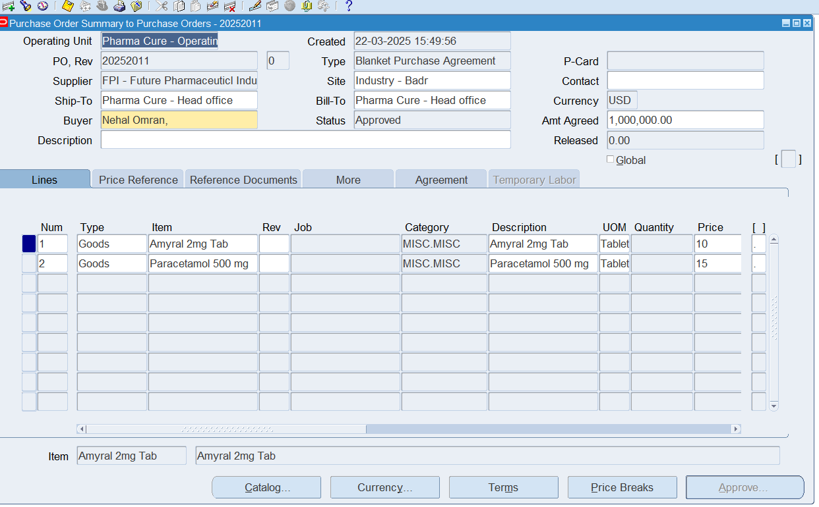
Blanket Purchase Agreement

Slide 48
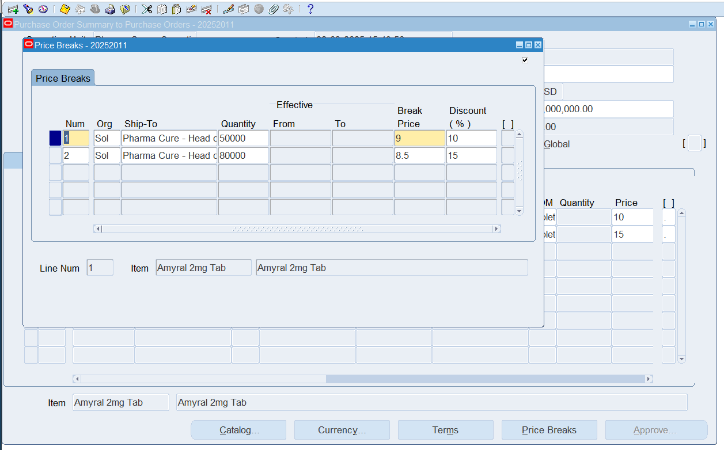
Price Break

Slide 49
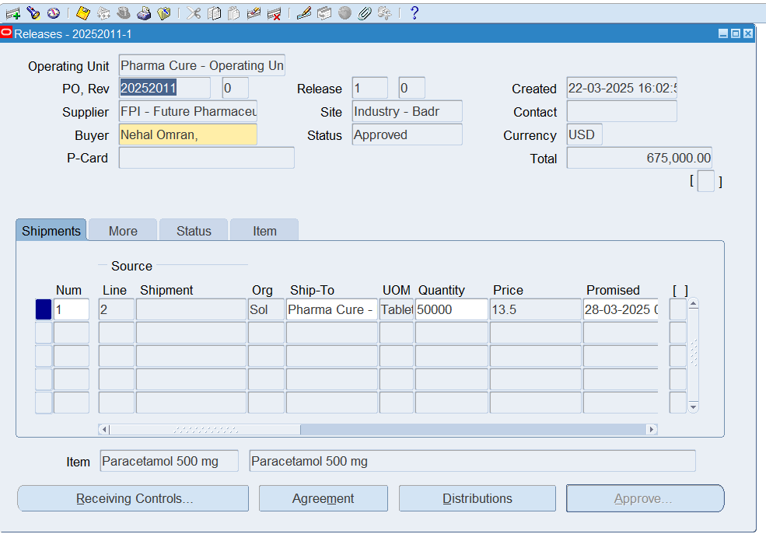
Blanket Release

Slide 50
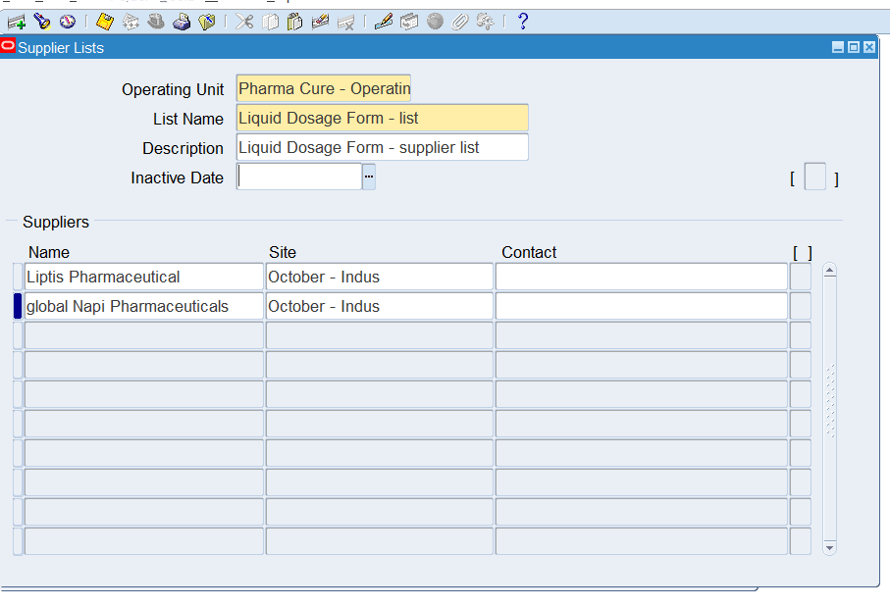
Supplier List

Slide 51
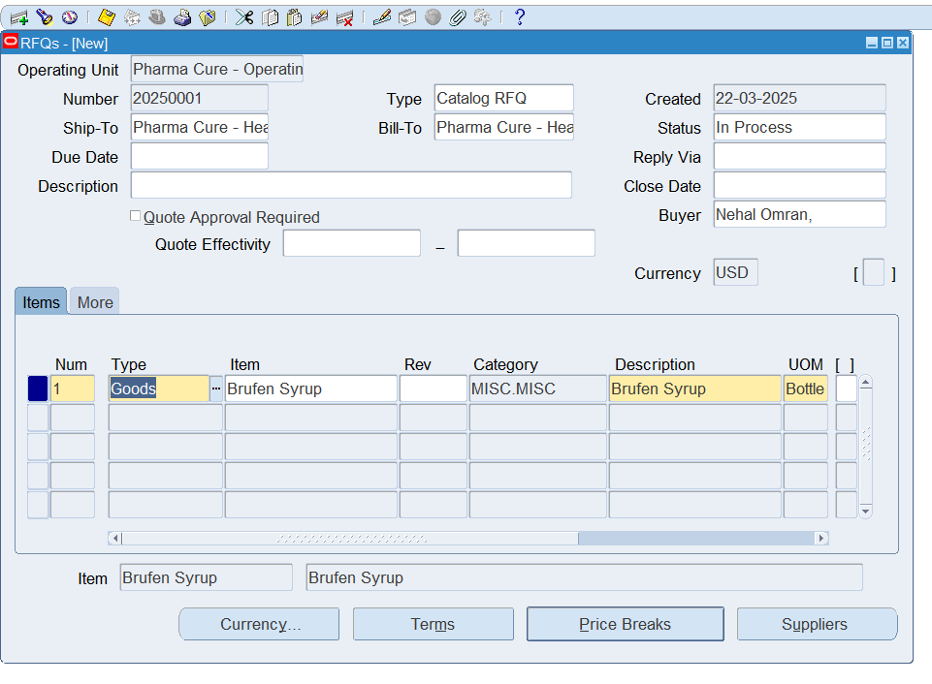
Create Request For Quotation

Slide 52
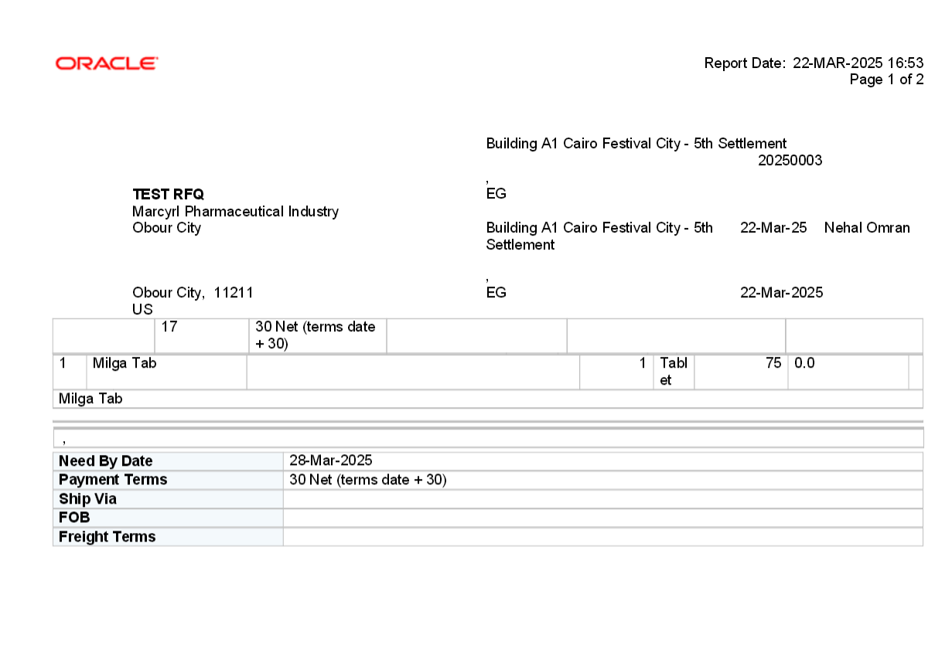
Printed Request For Quotation

Slide 53
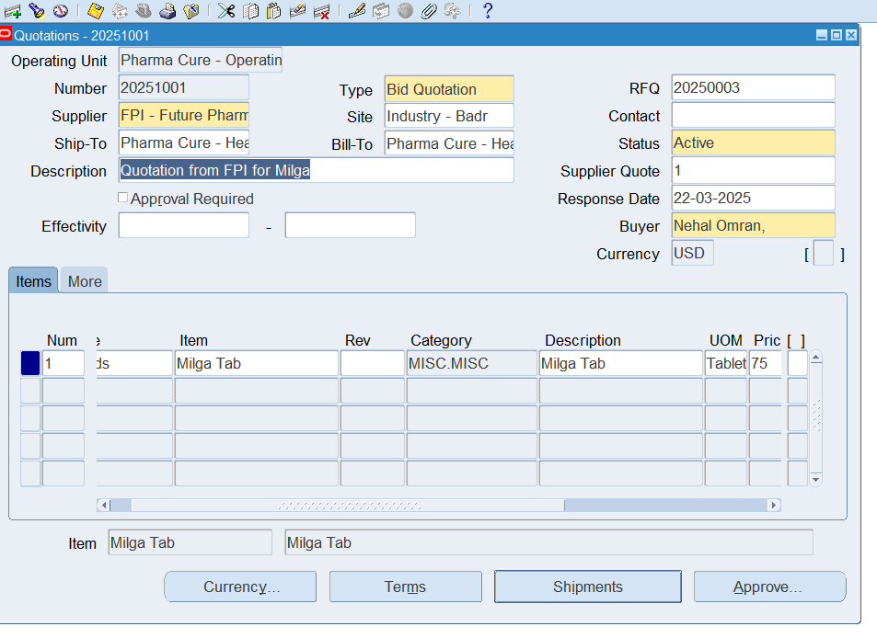
Create Quotation

Slide 54
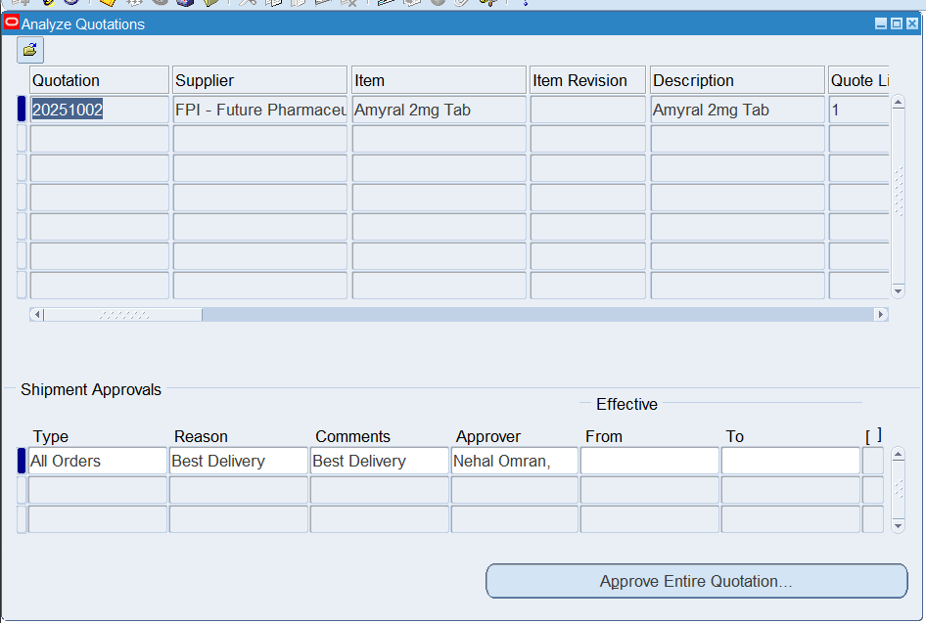
Quotation Analysis

Slide 55
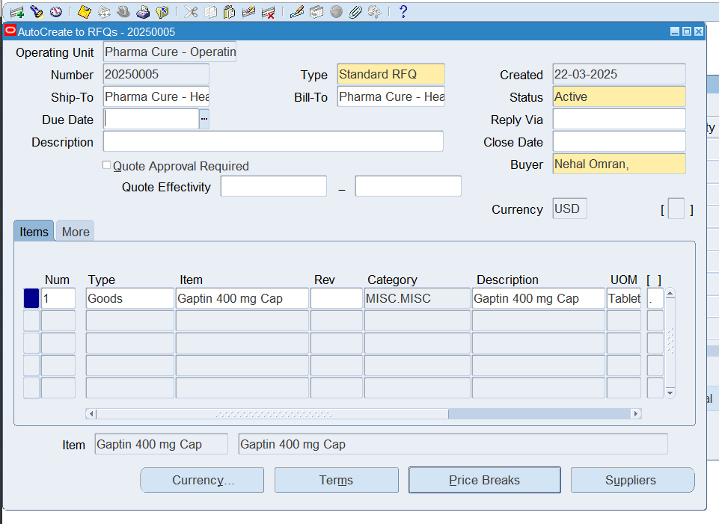
Auto Create Request For Quotation from PR

Slide 56
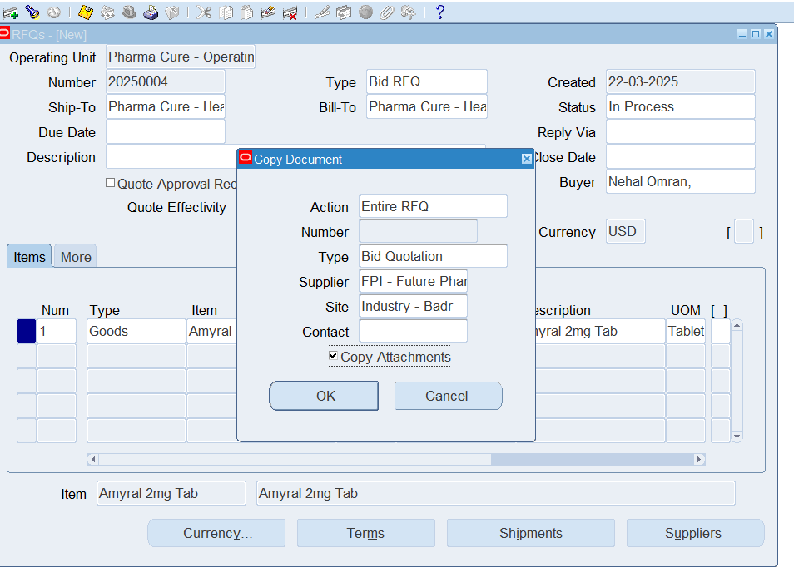
RFQ To Quotation

Slide 57
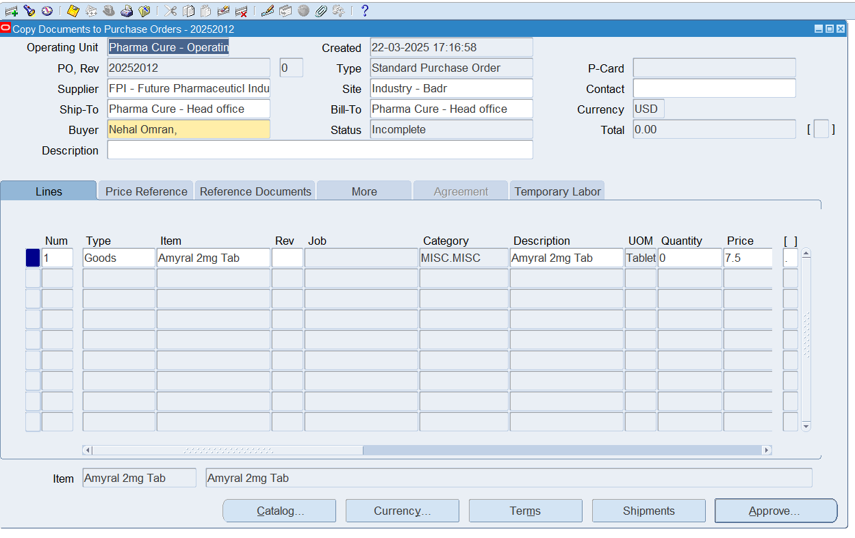
Auto Create PO from Quotation

Slide 58




Connect with us.
Email
hello@smartorasolutions.com
Social Media
@SmartOra Solutions
Call us
123-456-789

